Slide 2
Christmas Traditions…
Christmas decorations

Slide 3
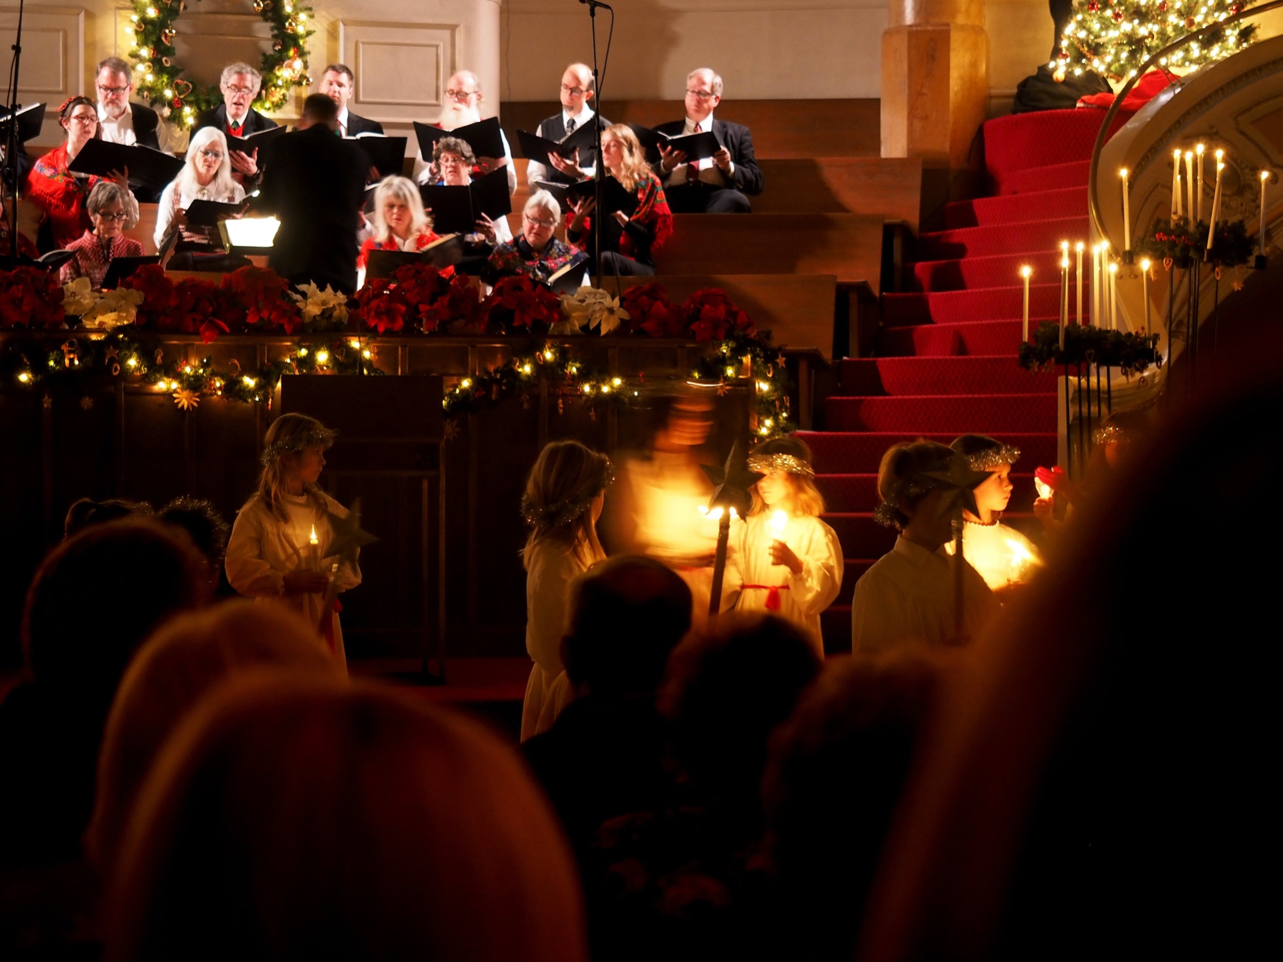
Christmas Traditions…
Christmas decorations
Music

Slide 4
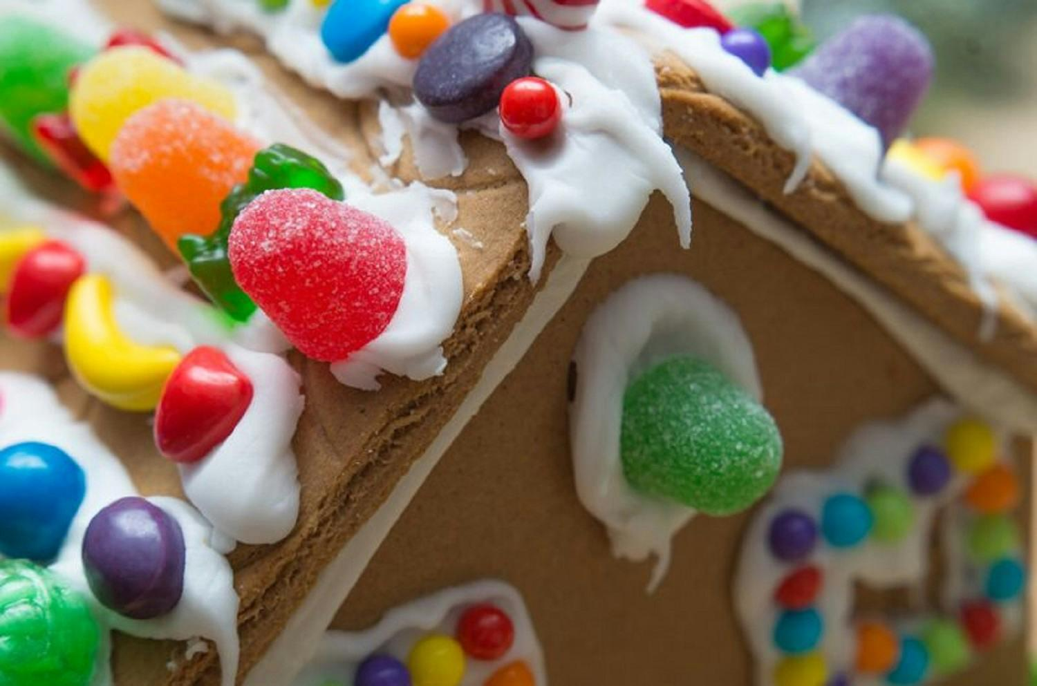
Christmas Traditions…
Christmas decorations
Music
Foods

Slide 5
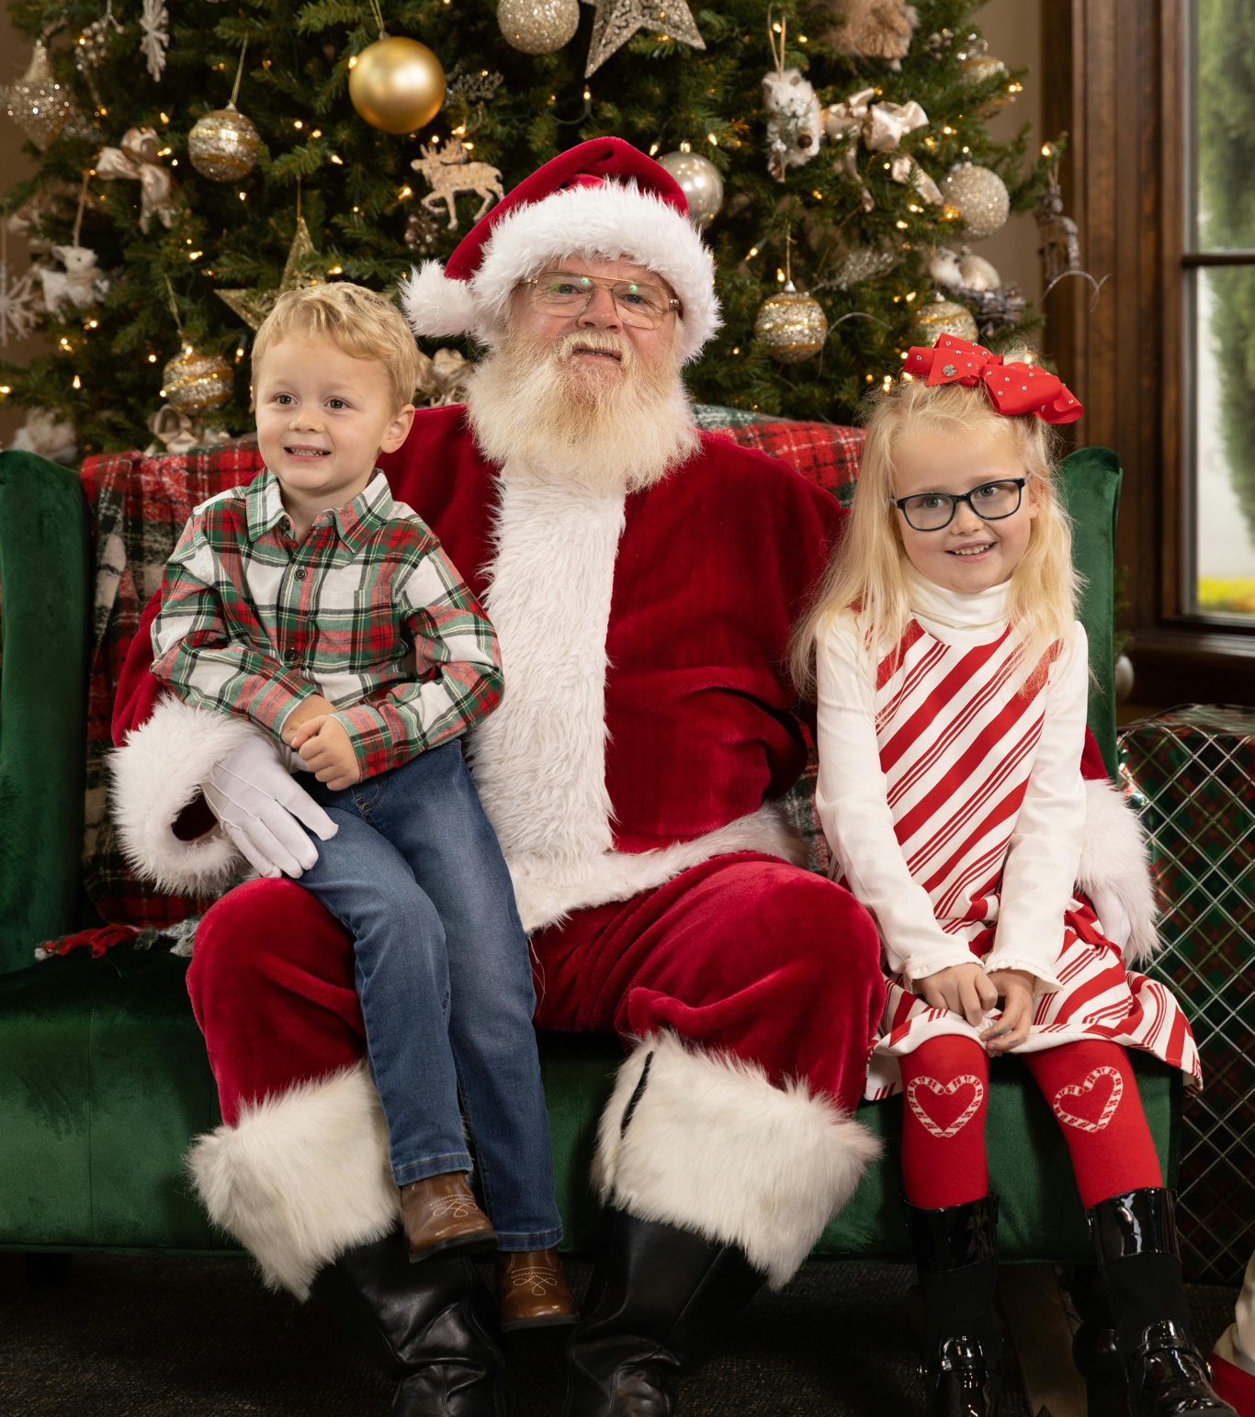
Christmas Traditions…
Christmas decorations
Music
Foods
Santa photos

Slide 6
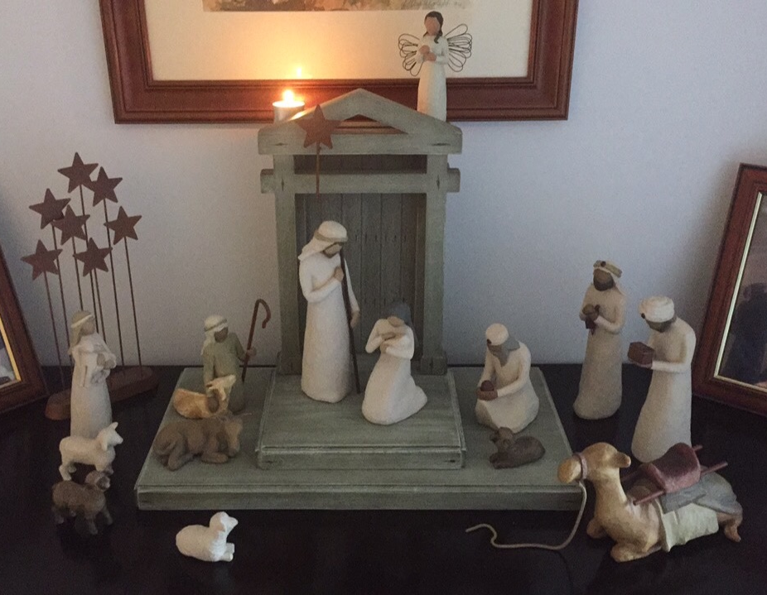
Christmas Traditions…
Nativity

Slide 7
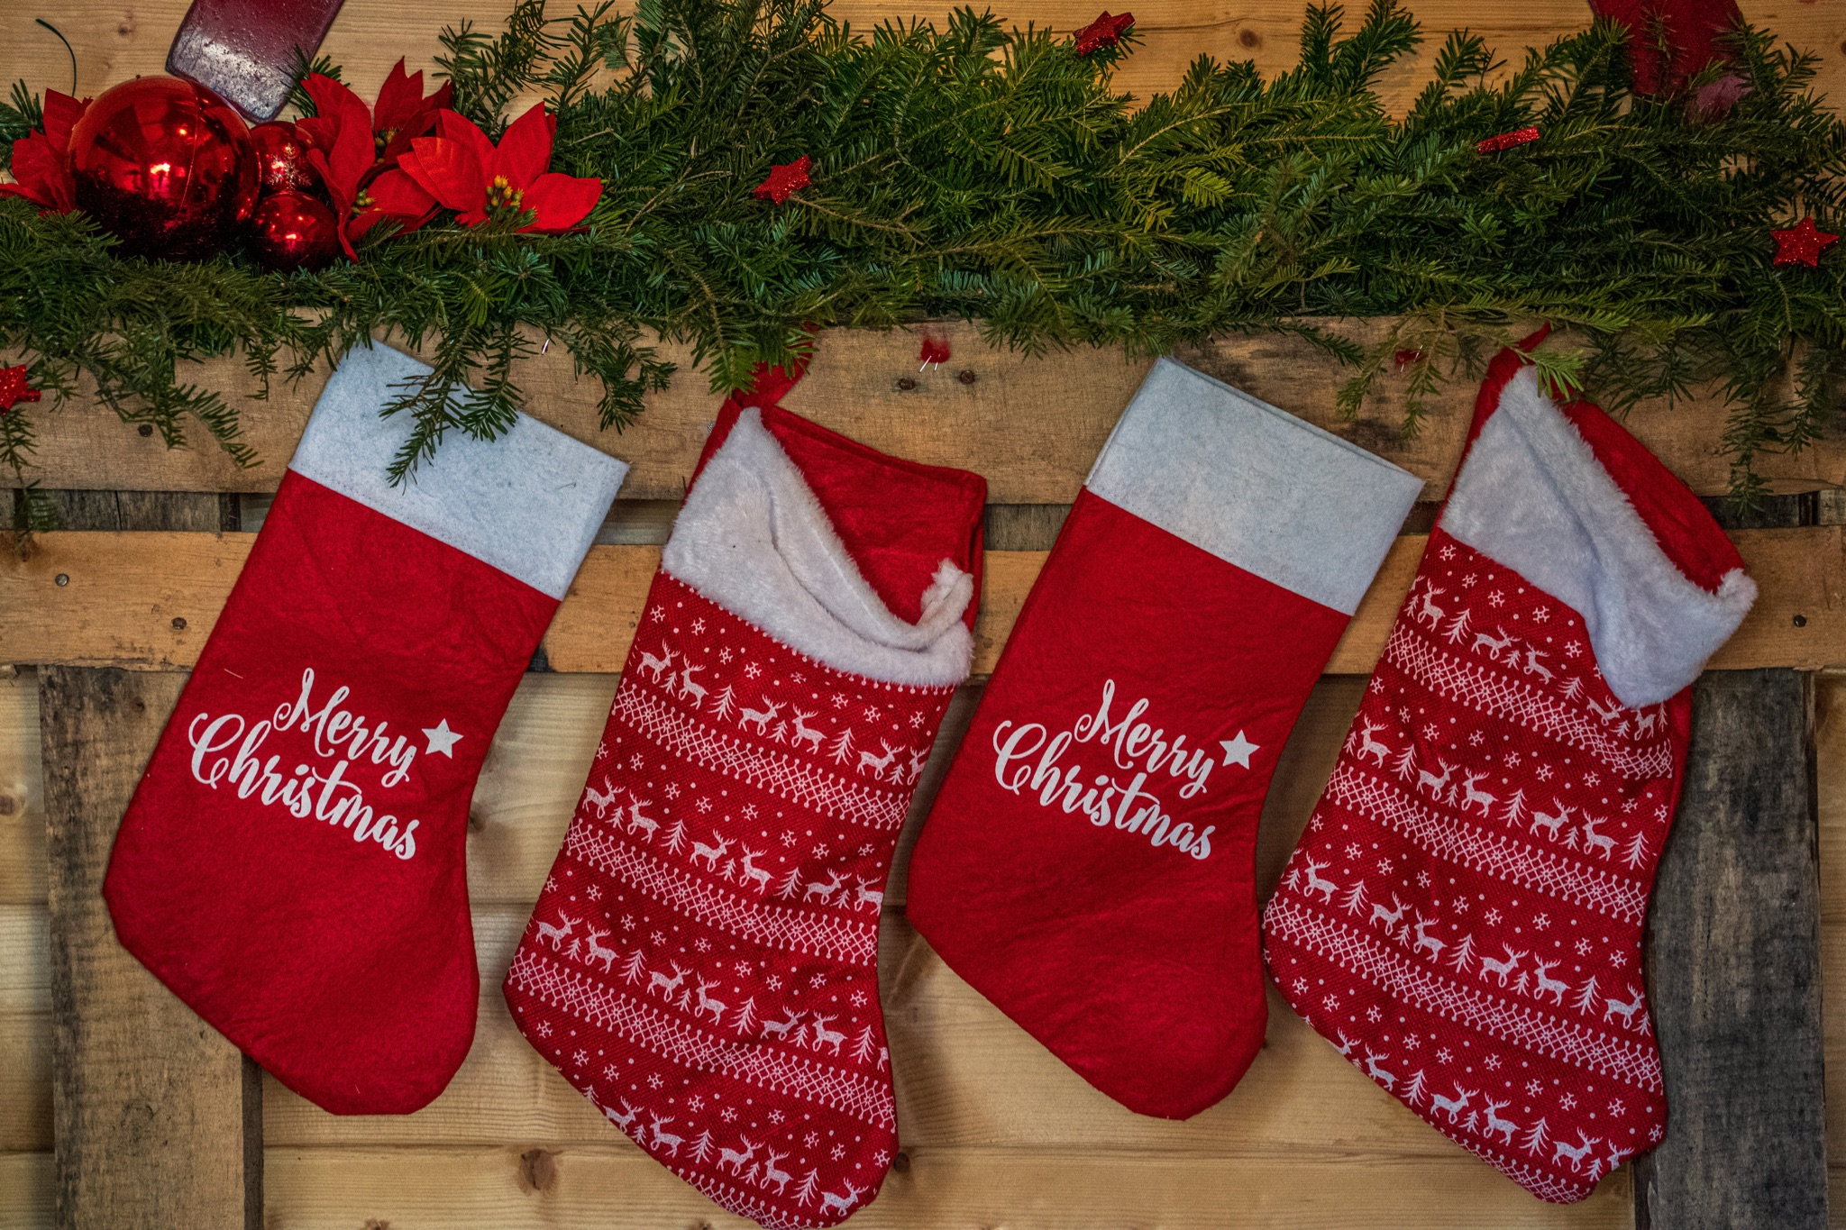
Christmas Traditions…
Nativity
Christmas stockings

Slide 8
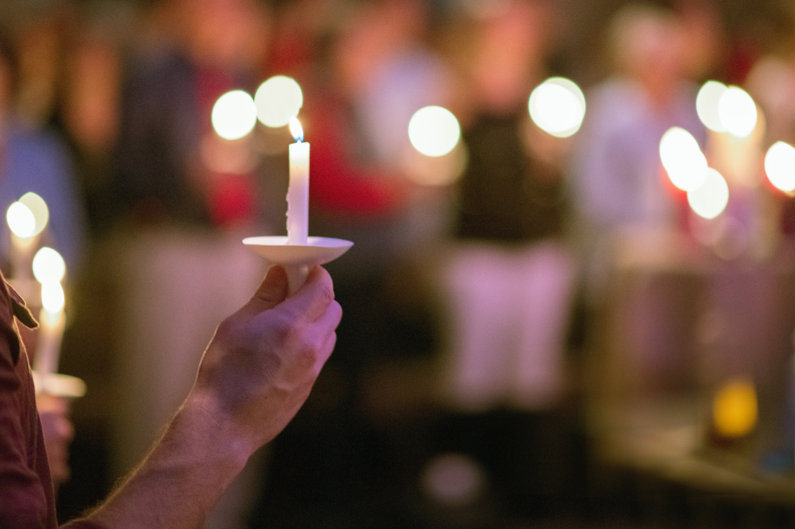
Christmas Traditions…
Nativity
Christmas stockings
Carols by Candlelight

Slide 9
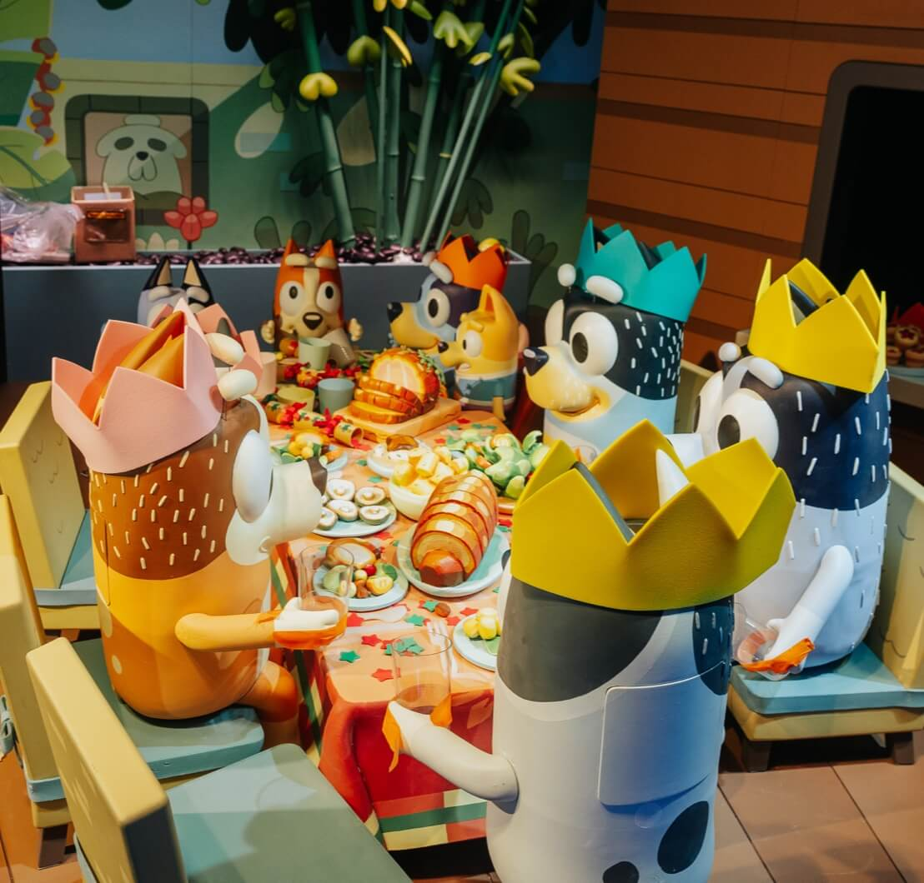
Christmas Traditions…
Nativity
Christmas stockings
Carols by Candlelight
Myer Christmas windows

Slide 10
Hope definition
A feeling of expectation and a desire for a particular thing to happen. (Oxford Languages)

Slide 11
Isaiah 9:6-7
For to us a child is born,
to us a son is given,
and the government will be on his shoulders.
And he will be called
Wonderful Counselor, Mighty God,
Everlasting Father, Prince of Peace.

Slide 12
Of the greatness of his government and peace
there will be no end.
He will reign on David’s throne
and over his kingdom,
establishing and upholding it
with justice and righteousness
from that time on and forever.
The zeal of the Lord Almighty
will accomplish this.

Slide 13
Luke 1:26-38
26 In the sixth month of Elizabeth’s pregnancy, God sent the angel Gabriel to Nazareth, a town in Galilee, 27 to a virgin pledged to be married to a man named Joseph, a descendant of David. The virgin’s name was Mary. 28 The angel went to her and said, “Greetings, you who are highly favored! The Lord is with you.”

Slide 14
29 Mary was greatly troubled at his words and wondered what kind of greeting this might be. 30 But the angel said to her, “Do not be afraid,Mary; you have found favor with God. 31 You will conceive and give birth to a son, and you are to call him Jesus. 32 He will be great and will be called the Son of the Most High. The Lord God will give him the throne of his father David, 33 and he will reign over Jacob’s descendants forever; his kingdom will never end.”
34 “How will this be,” Mary asked the angel, “since I am a virgin?”

Slide 15
29 Mary was greatly troubled at his words and wondered what kind of greeting this might be. 30 But the angel said to her, “Do not be afraid,Mary; you have found favor with God. 31 You will conceive and give birth to a son, and you are to call him Jesus. 32 He will be great and will be called the Son of the Most High. The Lord God will give him the throne of his father David, 33 and he will reign over Jacob’s descendants forever; his kingdom will never end.”
34 “How will this be,” Mary asked the angel, “since I am a virgin?”

Slide 16
Of the greatness of his government and peace
there will be no end.
He will reign on David’s throne
and over his kingdom,
establishing and upholding it
with justice and righteousness
from that time on and forever.
The zeal of the Lord Almighty
will accomplish this.

Slide 17
Hebrews 11:1-2
“Now faith is confidence in what we hope for and assurance about what we do not see. This is what the ancients were commended for.”

Slide 18
Hebrews 11:1-2 & 13
“Now faith is confidence in what we hope for and assurance about what we do not see. This is what the ancients were commended for.”
“All these people were still living by faith when they died. They did not receive the things promised; they only saw them and welcomed them from a distance, admitting that they were foreigners and strangers on earth.”

Slide 19
Where is the hope???
Statistics from the US indicate that 40-50% of adolescents suffer from feelings of hopelessness.
Approximately 20% of Australian adults experience periods of hopelessness and for about 10% their life is significantly impacted by ongoing feelings of hopelessness

Slide 20
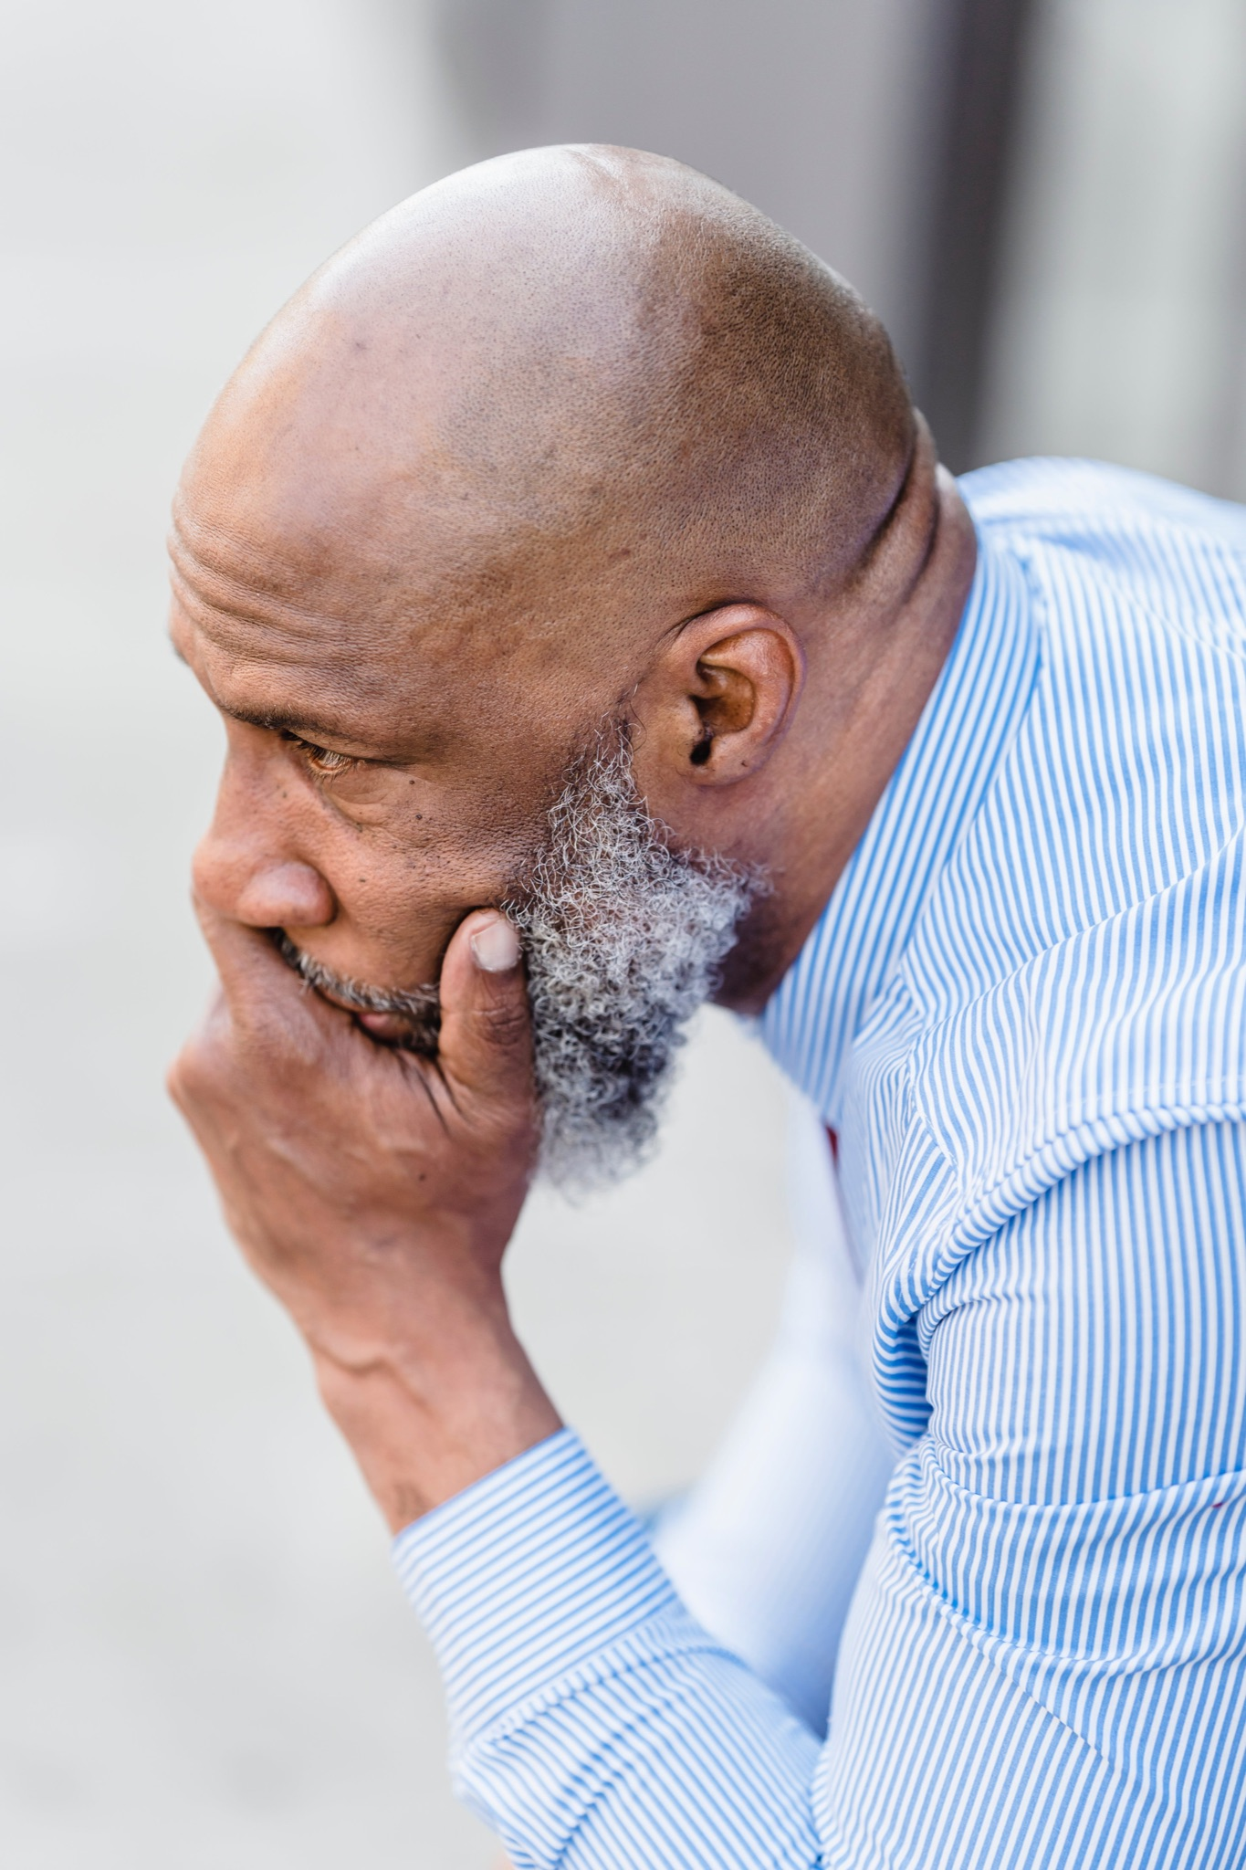
Current concerns
Rising interest rates
Financial insecurity
Health concerns
War
Inequality
Plenty more…

Slide 21
